Slide 1
Learning Objective
I will be able to determine the average and instantaneous rate of change.
Success Criteria
At the end of the lesson, I will be able to:
Determine the average and instantaneous rate of change

Slide 2
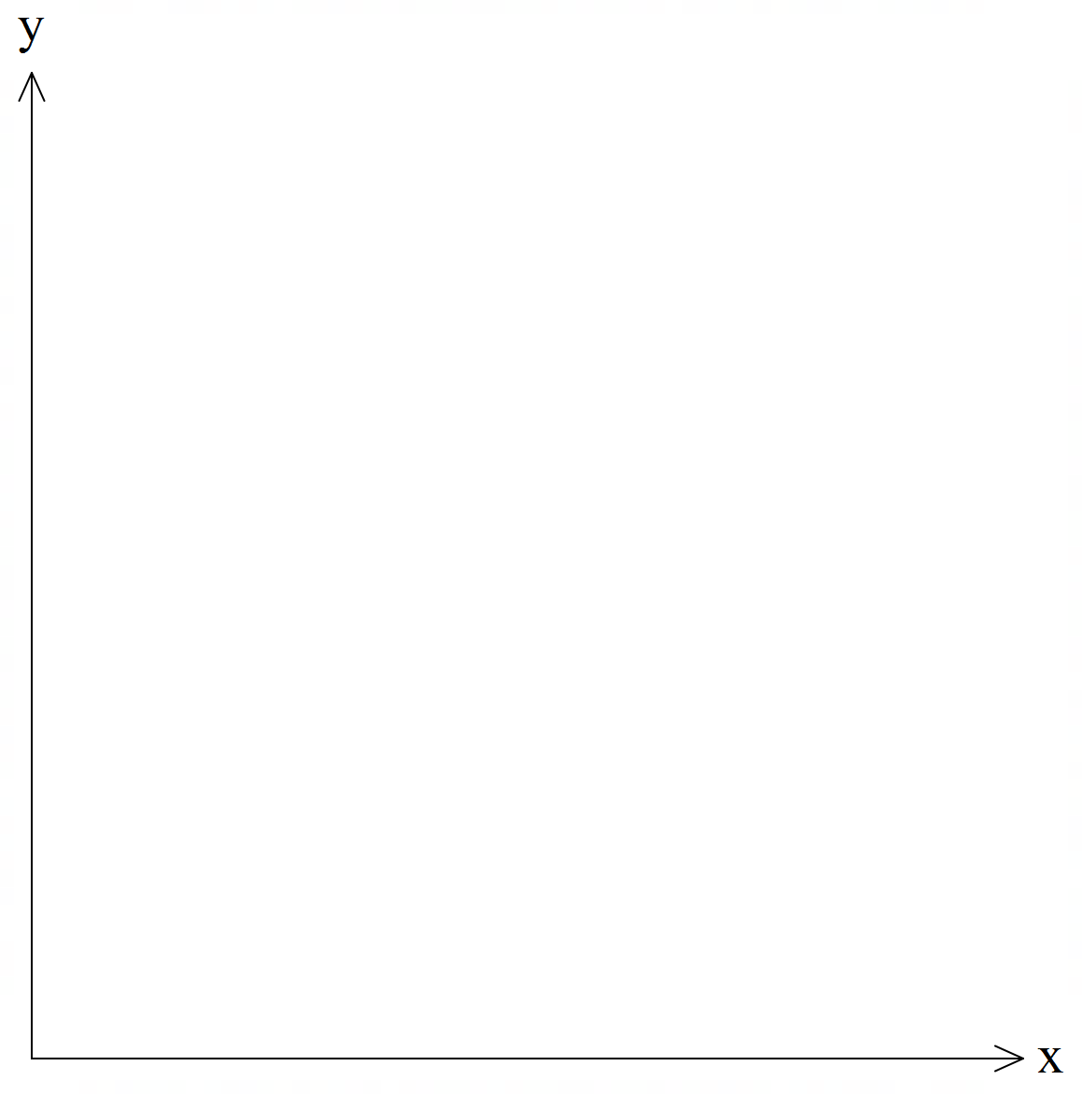
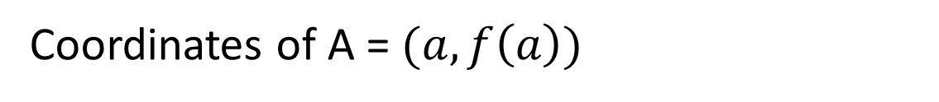

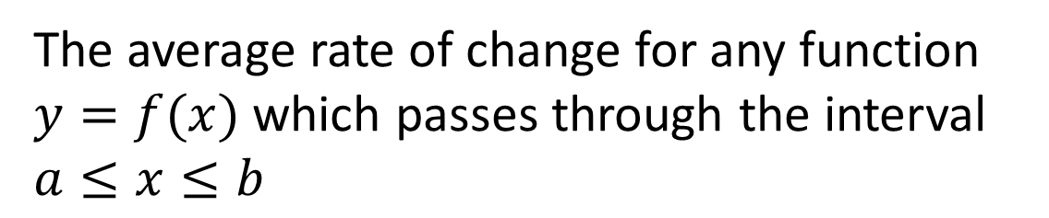

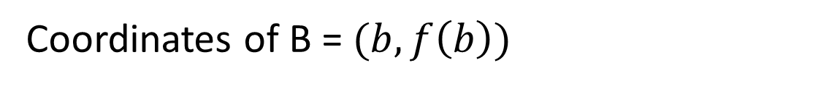

Average rate of change for a function
Activating Prior Knowledge
The average rate of change for any function $y=f(x)$ which passes through the interval $a≤x≤b$
B
Coordinates of A = $(a,f\left(a\right))$
$$(b,f(ba)$$
A
$$(a,f\left(a\right))$$
Coordinates of B = $(b,f\left(b\right))$
Rate of change$=\frac{f\left(b\right)−f\left(a\right)}{b−a}$

Slide 3
Instantaneous rate of change
Activating Prior Knowledge
Tangent line: A line that touches a curve at a single point and does not cross through it
A
Instantaneous rate of change:
The change in the rate at a particular instant
Draw a tangent line passing through the point
Find the gradient of the tangent line

Slide 4
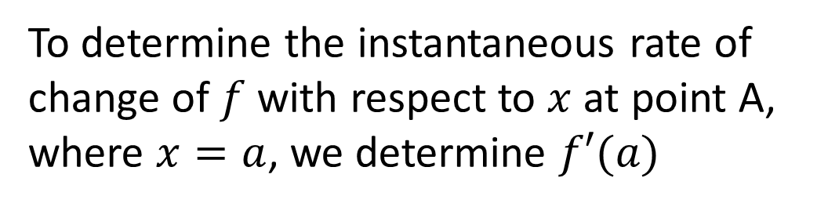
Instantaneous rate of change
Activating Prior Knowledge
To determine the instantaneous rate of change of $f$ with respect to $x$ at point A, where $x=a$, we determine $f′(a)$
A

Slide 5
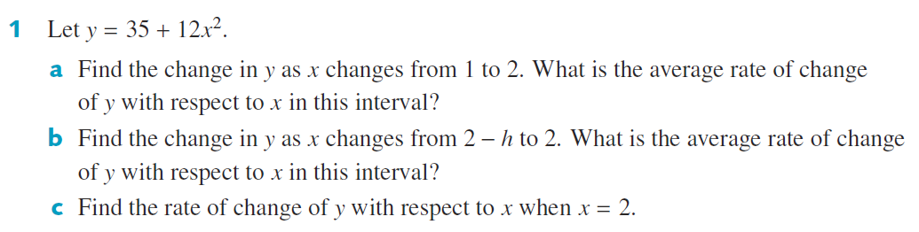
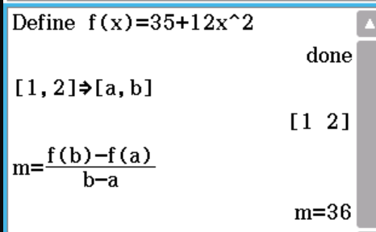

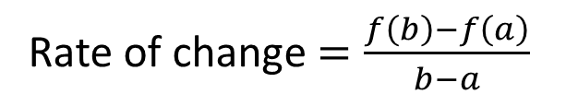
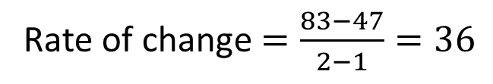
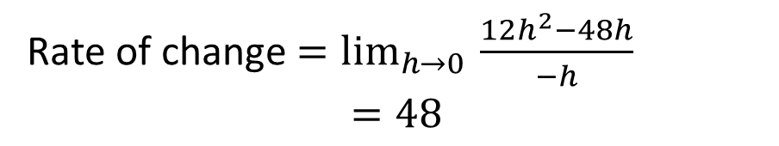

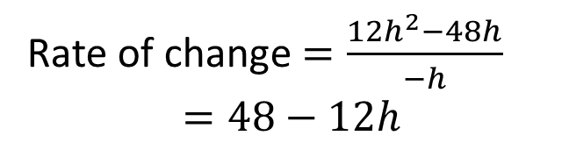

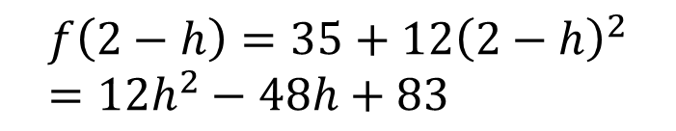
Guided Practice
Rate of change $=\frac{f\left(b\right)−f\left(a\right)}{b−a}$
$$f\left(2\right)=83$$
$$f\left(2\right)=83$$
$$f\left(2−h\right)=35+12{\left(2−h\right)}^{2} \\ =12h^{2}−48h+83$$
$$f\left(1\right)=47$$
Rate of change $=\frac{83−47}{2−1}=36$
Rate of change $=\frac{12h^{2}−48h}{−h}$ $$=48−12h$$
Rate of change $=\lim_{h→0 }{\frac{12h^{2}−48h}{−h}}$ $$=48$$

Slide 6
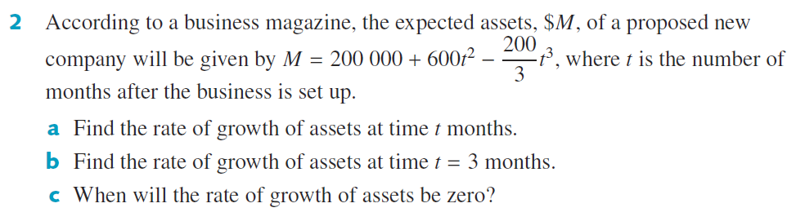

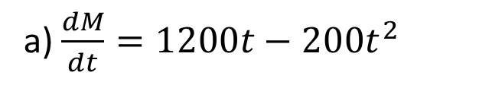


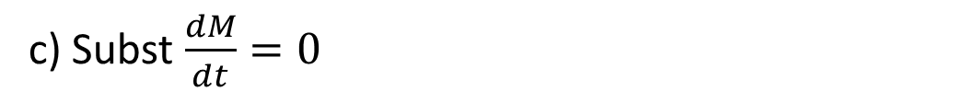


Guided Practice
a) $\frac{dM}{dt}=1200t−200t^{2}$
b) Subst $x=3 into\frac{dM}{dt},\frac{dM}{dt}=\$1800 per month$
c) Subst $\frac{dM}{dt}=0$
$$1200t−200t^{2}=0$$
$$t\left(1200−200t\right)=0$$
$$t=0$$
$$1200−200t=0$$
$$t=6$$

Slide 7
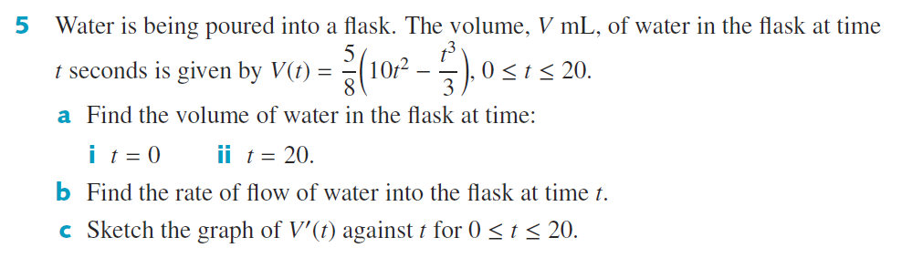
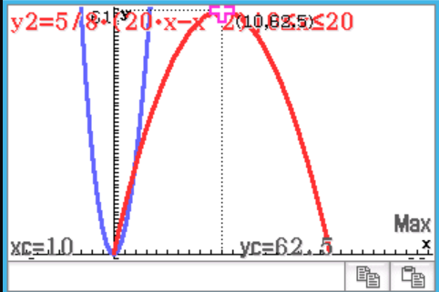

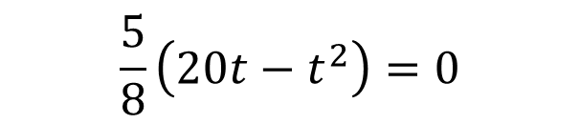
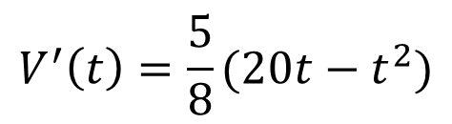
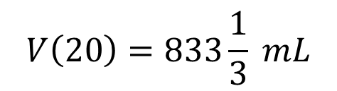
Guided Practice
$$V\left(0\right)=0 mL$$
$$V\left(20\right)=833\frac{1}{3} mL$$
$$V^{′}\left(t\right)=\frac{5}{8}(20t−t^{2})$$
$$\frac{5}{8}\left(20t−t^{2}\right)=0$$

Slide 8
Independent Practice
Complete Cambridge Ex 18B

